Slide 1
CONSTRAINT SATISFACTION PROBLEMS
Course Code: CSC4226
Course Title: Artificial Intelligence and Expert System
Dept. of Computer Science
Faculty of Science and Technology
Lecture No: | Eight (7) | Week No: | Eight (8) | Semester:
Lecturer: | Dr. Ashraf Uddin dr.ashraf@aiub.edu

Slide 2
Lecture Outline
Defining CSP
Varieties of CSPs
Backtracking Search for CSPs
Forward Checking
Constraint Propagation
Heuristics for CSP
Problem Structure

Slide 3
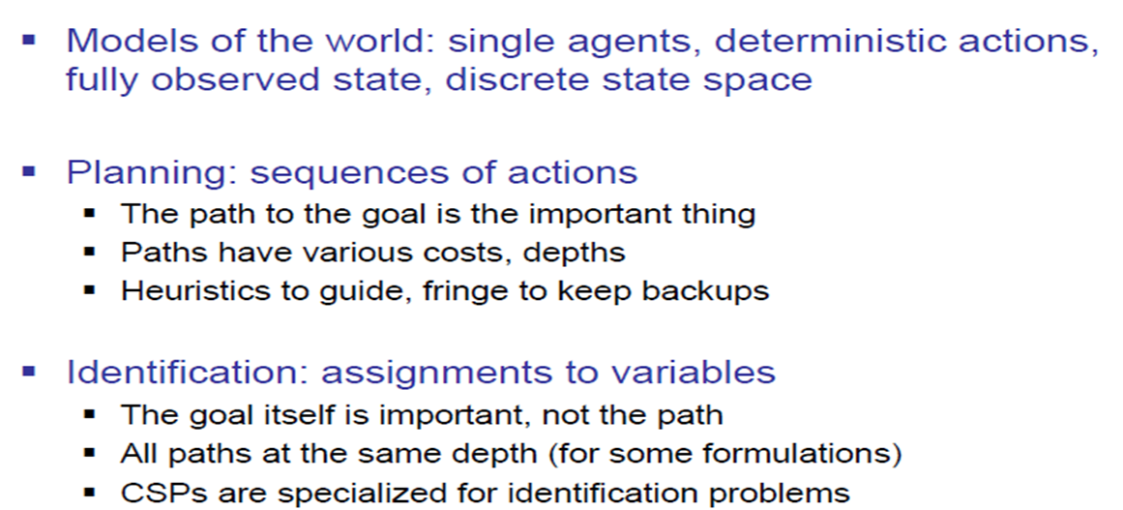
What is Search For?

Slide 4
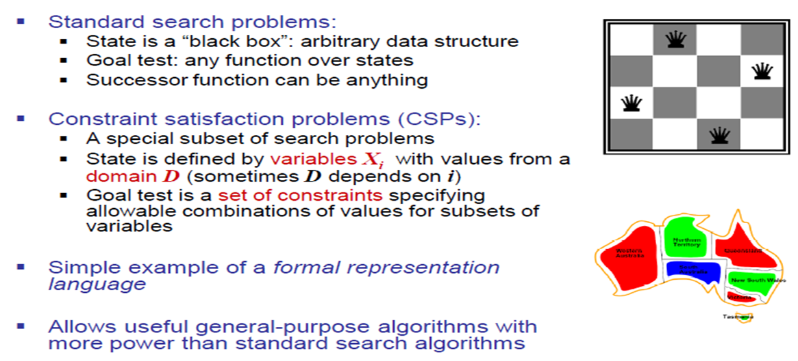
Constraint Satisfaction Problems

Slide 5
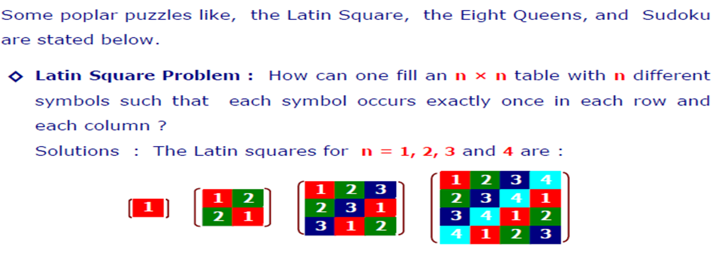
Example of CSPs

Slide 6
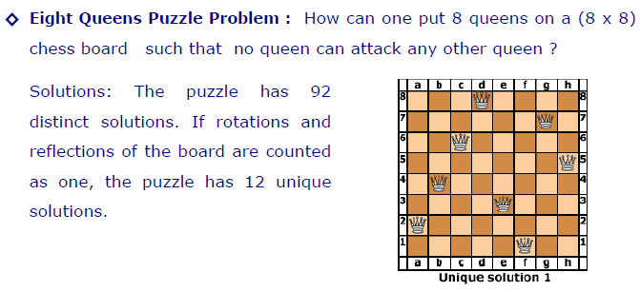
Example of CSPs

Slide 7
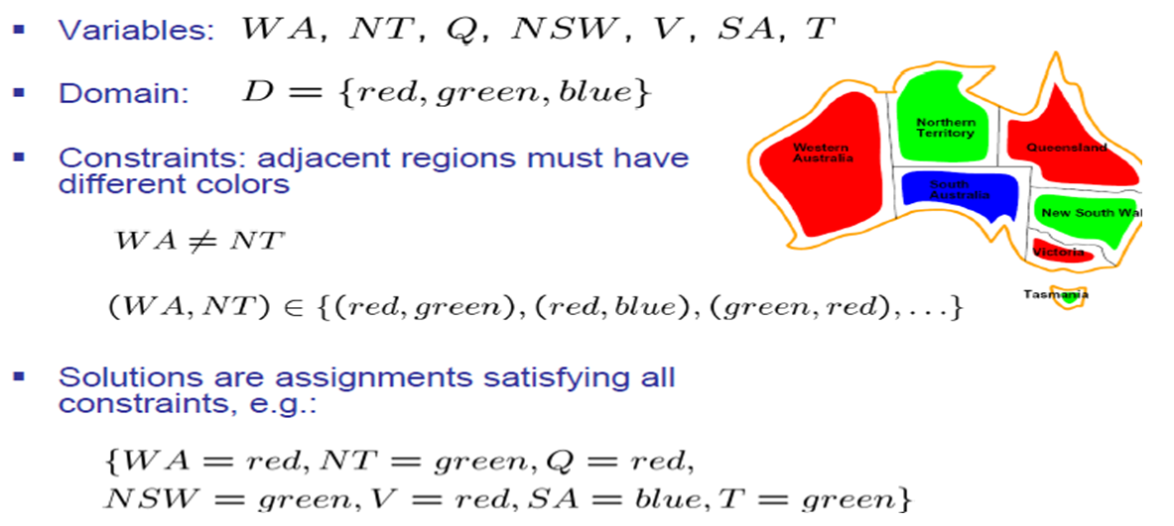
Example CSP: Map Coloring

Slide 8
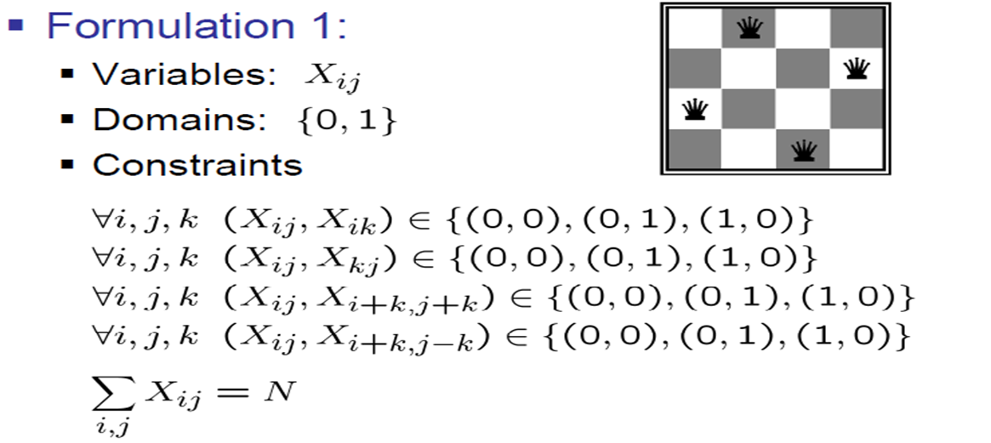
Example: N-Queens

Slide 9
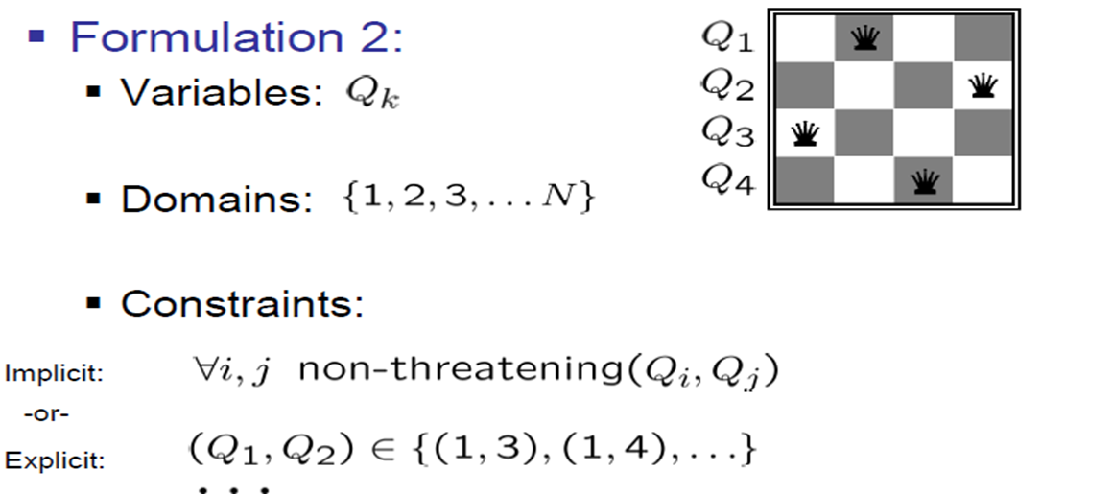
Example: N-Queens

Slide 10
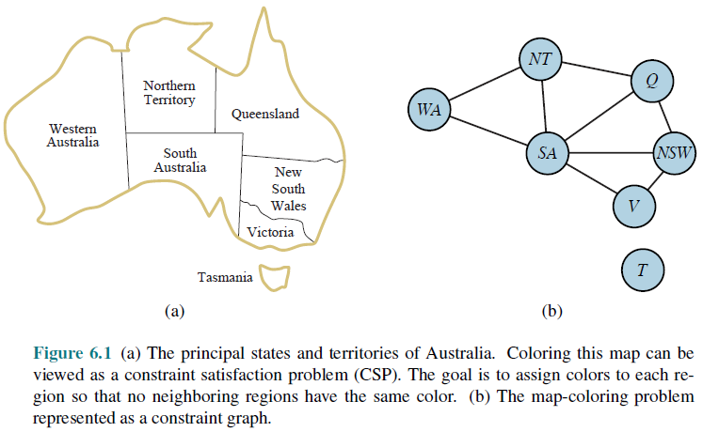
Constraint Graph

Slide 11
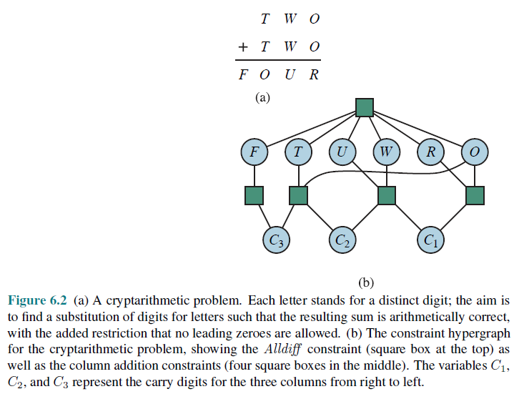
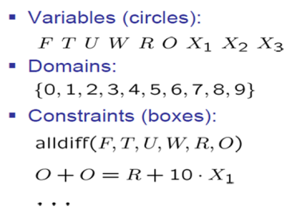
Example CSP: Cryptarithmetic

Slide 12
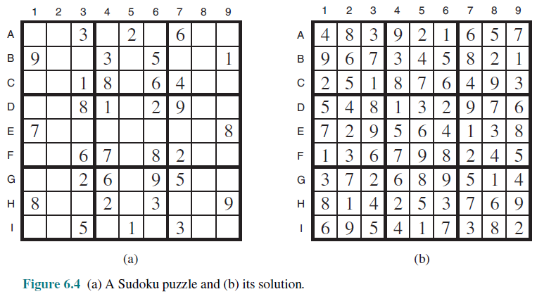
Example: Sudoku

Slide 13
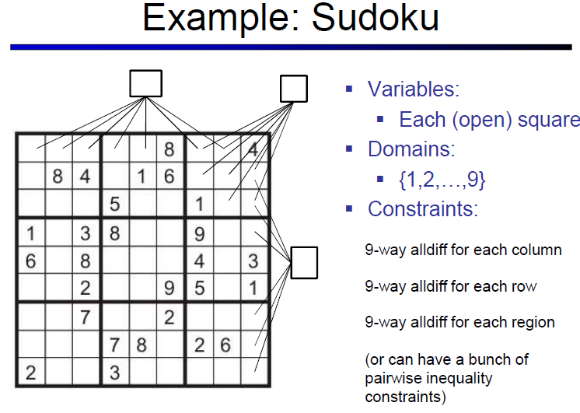
Topic Heading..

Slide 14
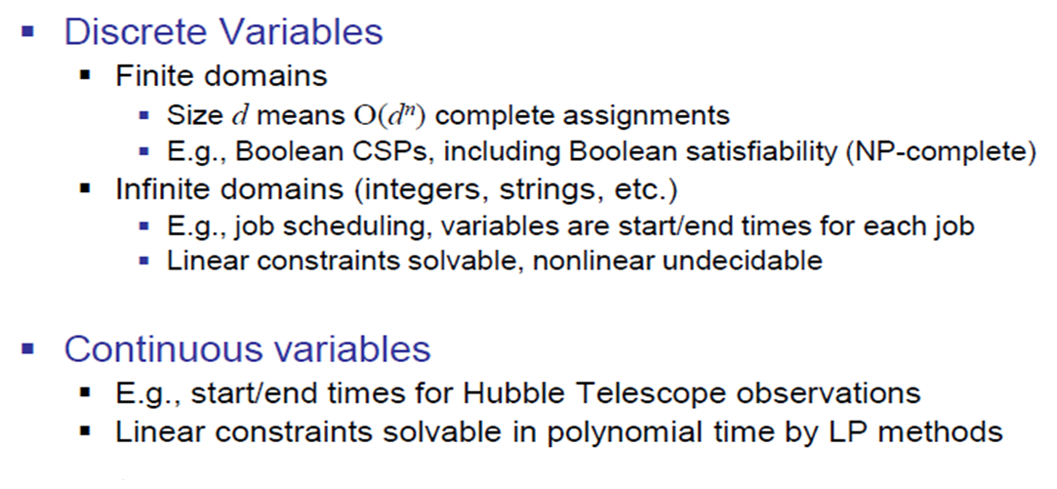
Varieties of CSPs

Slide 15
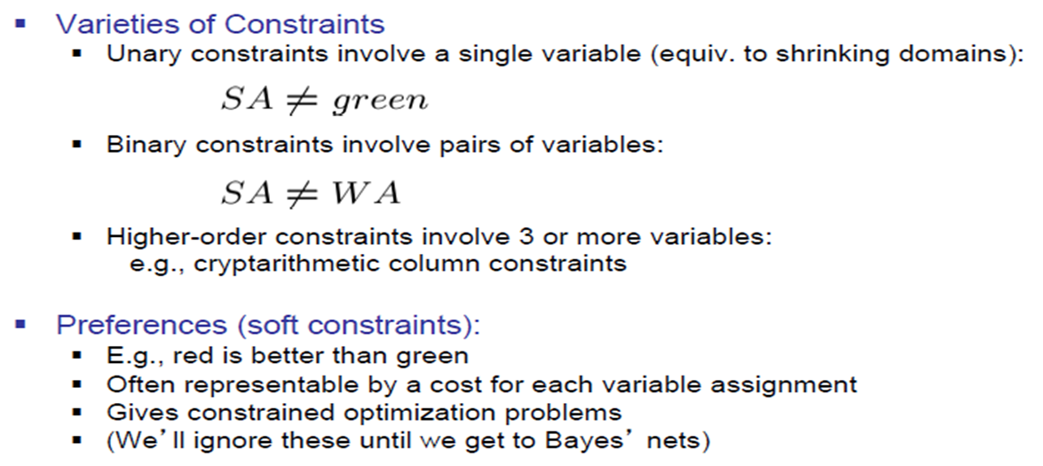
Varieties of Constraints

Slide 16
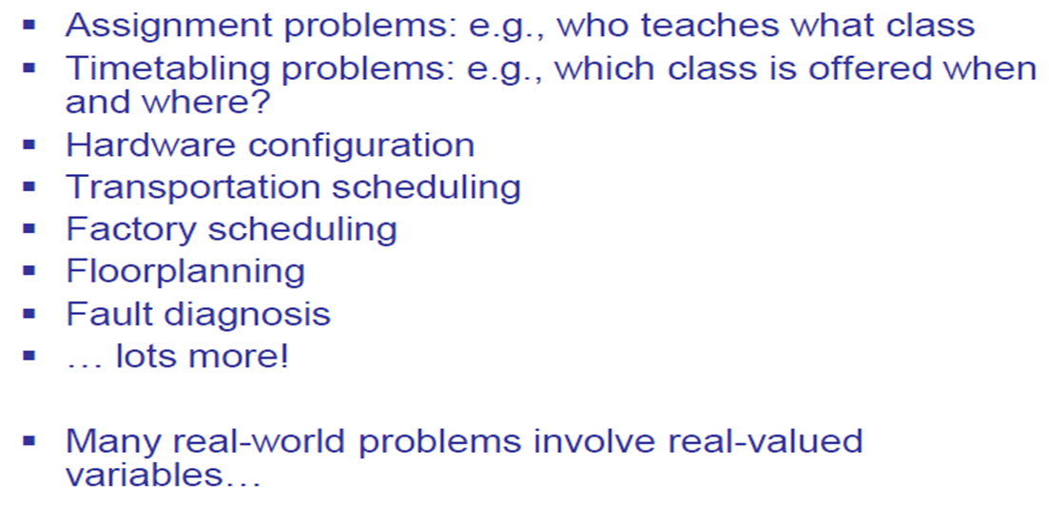
Real World CSPs

Slide 17
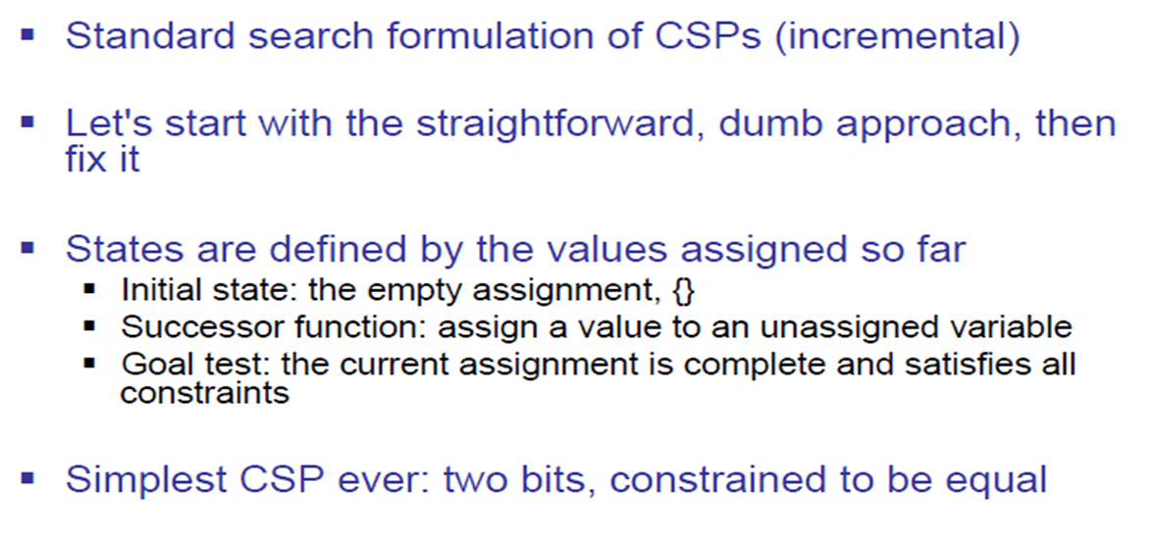
Standard Search Formulation

Slide 18
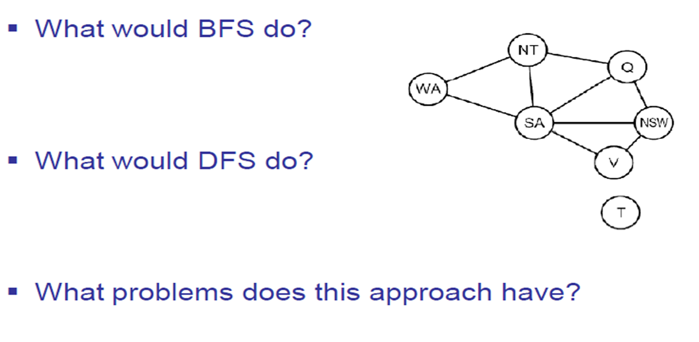
Search Methods

Slide 19
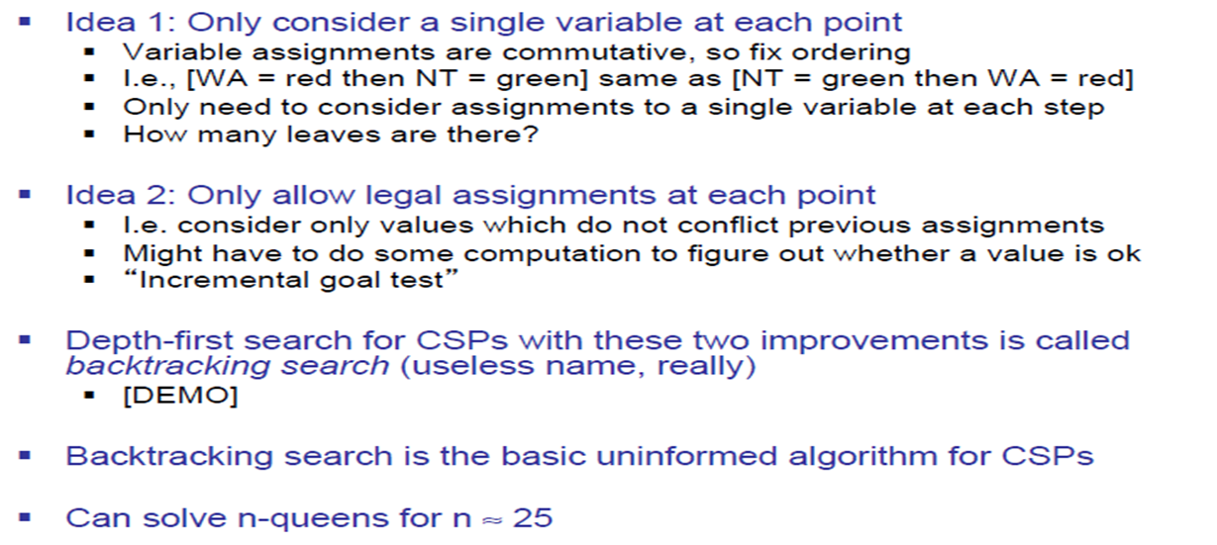
Backtracking Search

Slide 20
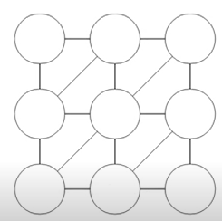
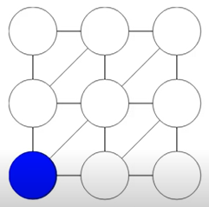
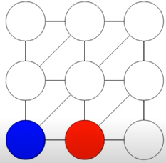
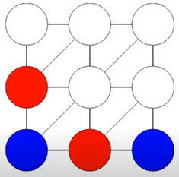
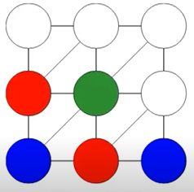
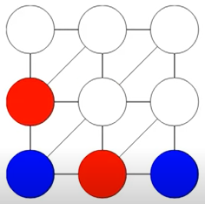
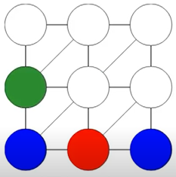
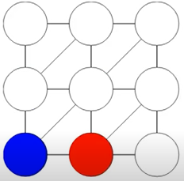
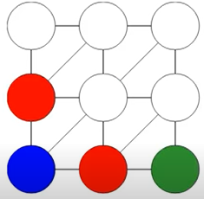
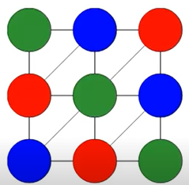
Demonstration
Assigning Value from Domain = { Blue, Red, Green} To Each Variables (circles)
from Left to Right Order
NO COLOR TO ASSIGN NEXT. BACKTRACK

Slide 21
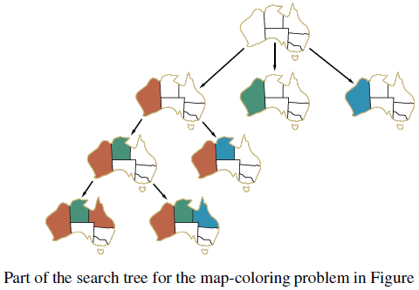
Backtracking Example

Slide 22
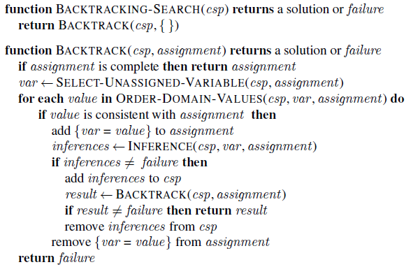
Backtracking Search

Slide 23
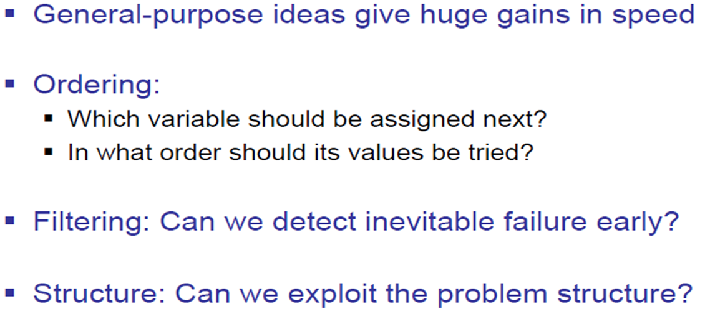
Improving Backtracking

Slide 24
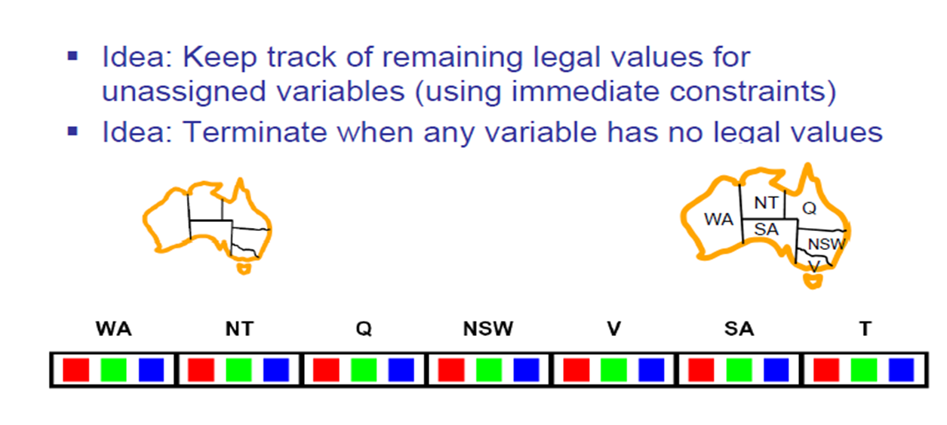
Filtering: Forward Checking

Slide 25
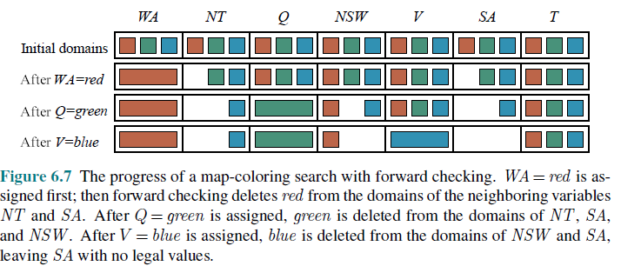
Progress of Map Coloring

Slide 26
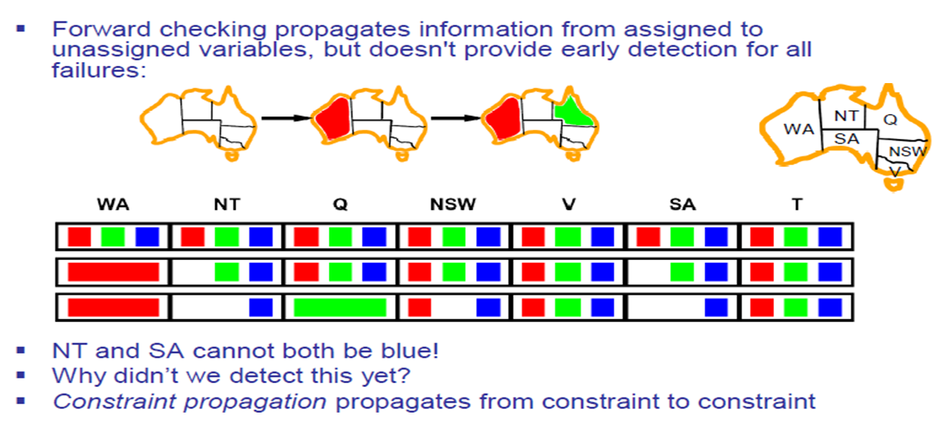
Filtering: Constraint Propagation

Slide 27
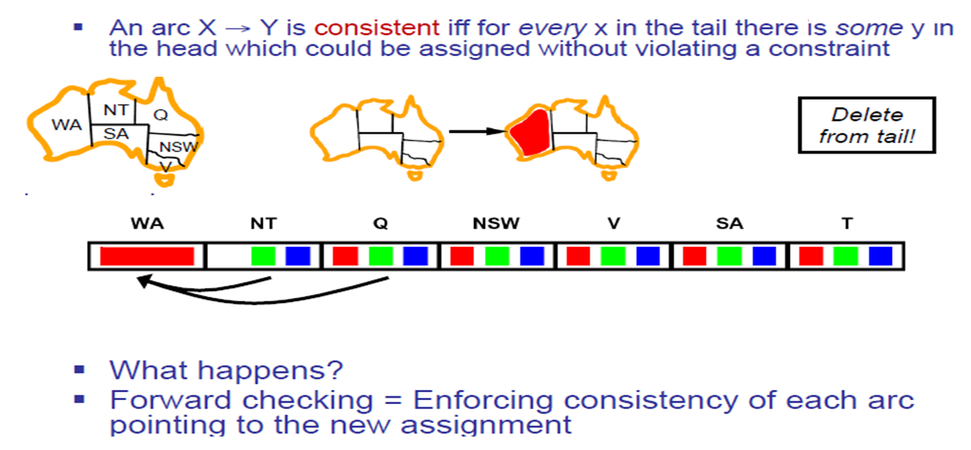
Consistency of An Arc

Slide 28
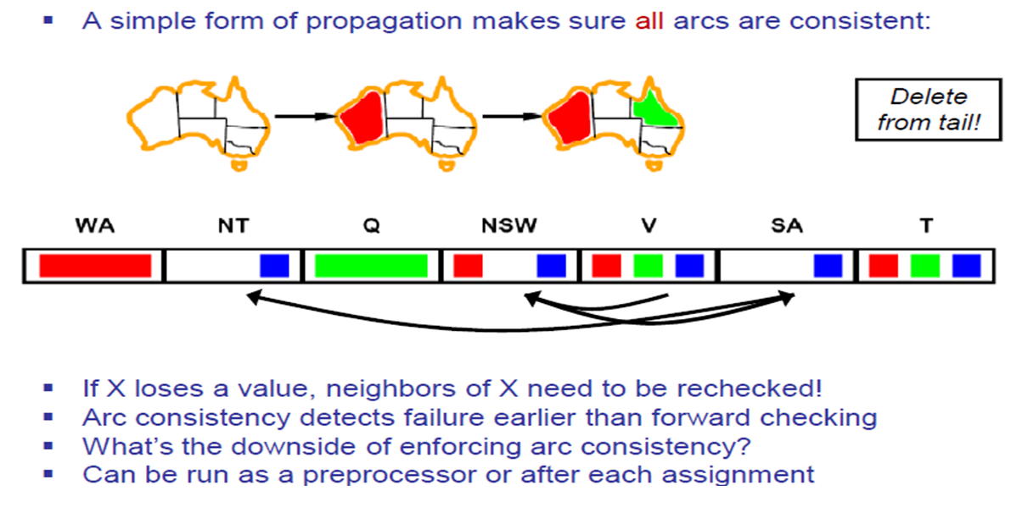
Arc Consistency of a CSP

Slide 29
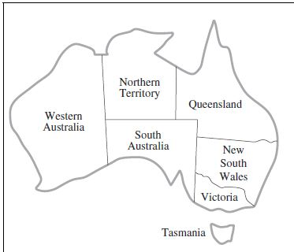
Arc Consistency of a CSP
Variable
WA = {R, G, B}
NT= {R, G, B}
Q= {R, G, B}
NSW= {R, G, B}
V = {R, G, B}
SA= {R, G, B}
T= {R, G, B}
Constraints
SA≠WA
SA≠NT
SA≠Q
SA≠NSW
SA≠V
WA≠NT
NT≠Q
Q≠NSW
NSW≠V
Constraints
WA≠SA
NT≠SA
Q≠SA
NSW≠SA
V≠SA
NT≠WA
Q≠NT
NSW≠Q
V≠NSW

Slide 30
Arc Consistency of a CSP
Variable
WA = {R}
NT= {R, G, B}
Q= {R, G, B}
NSW= {R, G, B}
V = {R, G, B}
SA= {R, G, B}
T= {R, G, B}
Constraints
SA≠WA
SA≠NT
SA≠Q
SA≠NSW
SA≠V
WA≠NT
NT≠Q
Q≠NSW
NSW≠V
Constraints
WA≠SA
NT≠SA
Q≠SA
NSW≠SA
V≠SA
NT≠WA
Q≠NT
NSW≠Q
V≠NSW

Slide 31
Arc Consistency of a CSP
Variable
WA = {R}
NT= {R, G, B}
Q= {R, G, B}
NSW= {R, G, B}
V = {R, G, B}
SA= {R, G, B}
T= {R, G, B}
Constraints
SA≠WA
SA≠NT
SA≠Q
SA≠NSW
SA≠V
WA≠NT
NT≠Q
Q≠NSW
NSW≠V
Constraints
WA≠SA
NT≠SA
Q≠SA
NSW≠SA
V≠SA
NT≠WA
Q≠NT
NSW≠Q
V≠NSW

Slide 32
Arc Consistency of a CSP
Variable
WA = {R}
NT= {R, G, B}
Q= {R, G, B}
NSW= {R, G, B}
V = {R, G, B}
SA= {G, B}
T= {R, G, B}
Constraints
SA≠WA
SA≠NT
SA≠Q
SA≠NSW
SA≠V
WA≠NT
NT≠Q
Q≠NSW
NSW≠V
Constraints
WA≠SA
NT≠SA
Q≠SA
NSW≠SA
V≠SA
NT≠WA
Q≠NT
NSW≠Q
V≠NSW

Slide 33
Arc Consistency of a CSP
Variable
WA = {R}
NT= {R, G, B}
Q= {R, G, B}
NSW= {R, G, B}
V = {R, G, B}
SA= {G, B}
T= {R, G, B}
Constraints
SA≠WA
SA≠NT
SA≠Q
SA≠NSW
SA≠V
WA≠NT
NT≠Q
Q≠NSW
NSW≠V
Constraints
WA≠SA
NT≠SA
Q≠SA
NSW≠SA
V≠SA
NT≠WA
Q≠NT
NSW≠Q
V≠NSW

Slide 34
Arc Consistency of a CSP
Variable
WA = {R}
NT= {R, G, B}
Q= {R, G, B}
NSW= {R, G, B}
V = {R, G, B}
SA= {G, B}
T= {R, G, B}
Constraints
SA≠WA
SA≠NT
SA≠Q
SA≠NSW
SA≠V
WA≠NT
NT≠Q
Q≠NSW
NSW≠V
Constraints
WA≠SA
NT≠SA
Q≠SA
NSW≠SA
V≠SA
NT≠WA
Q≠NT
NSW≠Q
V≠NSW

Slide 35
Arc Consistency of a CSP
Variable
WA = {R}
NT= {G, B}
Q= {R, G, B}
NSW= {R, G, B}
V = {R, G, B}
SA= {G, B}
T= {R, G, B}
Constraints
SA≠WA
SA≠NT
SA≠Q
SA≠NSW
SA≠V
WA≠NT
NT≠Q
Q≠NSW
NSW≠V
Constraints
WA≠SA
NT≠SA
Q≠SA
NSW≠SA
V≠SA
NT≠WA
Q≠NT
NSW≠Q
V≠NSW

Slide 36
Arc Consistency of a CSP
Variable
WA = {R}
NT= {G, B}
Q= {R, G, B}
NSW= {R, G, B}
V = {R, G, B}
SA= {G, B}
T= {R, G, B}
Constraints
SA≠WA
SA≠NT
SA≠Q
SA≠NSW
SA≠V
WA≠NT
NT≠Q
Q≠NSW
NSW≠V
Constraints
WA≠SA
NT≠SA
Q≠SA
NSW≠SA
V≠SA
NT≠WA
Q≠NT
NSW≠Q
V≠NSW

Slide 37
Arc Consistency of a CSP
Variable
WA = {R}
NT= {G, B}
Q= {R, G, B}
NSW= {R, G, B}
V = {R, G, B}
SA= {G, B}
T= {R, G, B}
Constraints
SA≠WA
SA≠NT
SA≠Q
SA≠NSW
SA≠V
WA≠NT
NT≠Q
Q≠NSW
NSW≠V
Constraints
WA≠SA
NT≠SA
Q≠SA
NSW≠SA
V≠SA
NT≠WA
Q≠NT
NSW≠Q
V≠NSW

Slide 38
Arc Consistency of a CSP
Variable
WA = {R}
NT= {G, B}
Q= {R, G, B}
NSW= {R, G, B}
V = {R, G, B}
SA= {G, B}
T= {R, G, B}
Constraints
SA≠WA
SA≠NT
SA≠Q
SA≠NSW
SA≠V
WA≠NT
NT≠Q
Q≠NSW
NSW≠V
Constraints
WA≠SA
NT≠SA
Q≠SA
NSW≠SA
V≠SA
NT≠WA
Q≠NT
NSW≠Q
V≠NSW

Slide 39
Arc Consistency of a CSP
Variable
WA = {R}
NT= {G, B}
Q= {G}
NSW= {R, G, B}
V = {R, G, B}
SA= {G, B}
T= {R, G, B}
Constraints
SA≠WA
SA≠NT
SA≠Q
SA≠NSW
SA≠V
WA≠NT
NT≠Q
Q≠NSW
NSW≠V
Constraints
WA≠SA
NT≠SA
Q≠SA
NSW≠SA
V≠SA
NT≠WA
Q≠NT
NSW≠Q
V≠NSW

Slide 40
Arc Consistency of a CSP
Variable
WA = {R}
NT= {G, B}
Q= {G}
NSW= {R, G, B}
V = {R, G, B}
SA= {B}
T= {R, G, B}
Constraints
SA≠WA
SA≠NT
SA≠Q
SA≠NSW
SA≠V
WA≠NT
NT≠Q
Q≠NSW
NSW≠V
Constraints
WA≠SA
NT≠SA
Q≠SA
NSW≠SA
V≠SA
NT≠WA
Q≠NT
NSW≠Q
V≠NSW

Slide 41
Arc Consistency of a CSP
Variable
WA = {R}
NT= {B}
Q= {G}
NSW= {R, G, B}
V = {R, G, B}
SA= {B}
T= {R, G, B}
Constraints
SA≠WA
SA≠NT
SA≠Q
SA≠NSW
SA≠V
WA≠NT
NT≠Q
Q≠NSW
NSW≠V
Constraints
WA≠SA
NT≠SA
Q≠SA
NSW≠SA
V≠SA
NT≠WA
Q≠NT
NSW≠Q
V≠NSW

Slide 42
Arc Consistency of a CSP
Variable
WA = {R}
NT= {B}
Q= {G}
NSW= {R, G, B}
V = {R, G, B}
SA= {B}
T= {R, G, B}
Constraints
SA≠WA
SA≠NT
SA≠Q
SA≠NSW
SA≠V
WA≠NT
NT≠Q
Q≠NSW
NSW≠V
Constraints
WA≠SA
NT≠SA
Q≠SA
NSW≠SA
V≠SA
NT≠WA
Q≠NT
NSW≠Q
V≠NSW

Slide 43
Arc Consistency of a CSP
Variable
WA = {R}
NT= {B}
Q= {G}
NSW= {R, B}
V = {R, G, B}
SA= {B}
T= {R, G, B}
Constraints
SA≠WA
SA≠NT
SA≠Q
SA≠NSW
SA≠V
WA≠NT
NT≠Q
Q≠NSW
NSW≠V
Constraints
WA≠SA
NT≠SA
Q≠SA
NSW≠SA
V≠SA
NT≠WA
Q≠NT
NSW≠Q
V≠NSW

Slide 44
Arc Consistency of a CSP
Variable
WA = {R}
NT= {B}
Q= {G}
NSW= {R, B}
V = {R, G, B}
SA= {B}
T= {R, G, B}
Constraints
SA≠WA
SA≠NT
SA≠Q
SA≠NSW
SA≠V
WA≠NT
NT≠Q
Q≠NSW
NSW≠V
Constraints
WA≠SA
NT≠SA
Q≠SA
NSW≠SA
V≠SA
NT≠WA
Q≠NT
NSW≠Q
V≠NSW

Slide 45
Arc Consistency of a CSP
Variable
WA = {R}
NT= {B}
Q= {G}
NSW= {R, B}
V = {R, G, B}
SA= {B}
T= {R, G, B}
Constraints
SA≠WA
SA≠NT
SA≠Q
SA≠NSW
SA≠V
WA≠NT
NT≠Q
Q≠NSW
NSW≠V
Constraints
WA≠SA
NT≠SA
Q≠SA
NSW≠SA
V≠SA
NT≠WA
Q≠NT
NSW≠Q
V≠NSW

Slide 46
Arc Consistency of a CSP
Variable
WA = {R}
NT= {B}
Q= {G}
NSW= {R, B}
V = {R, G, B}
SA= {}
T= {R, G, B}
Constraints
SA≠WA
SA≠NT
SA≠Q
SA≠NSW
SA≠V
WA≠NT
NT≠Q
Q≠NSW
NSW≠V
Constraints
WA≠SA
NT≠SA
Q≠SA
NSW≠SA
V≠SA
NT≠WA
Q≠NT
NSW≠Q
V≠NSW

Slide 47
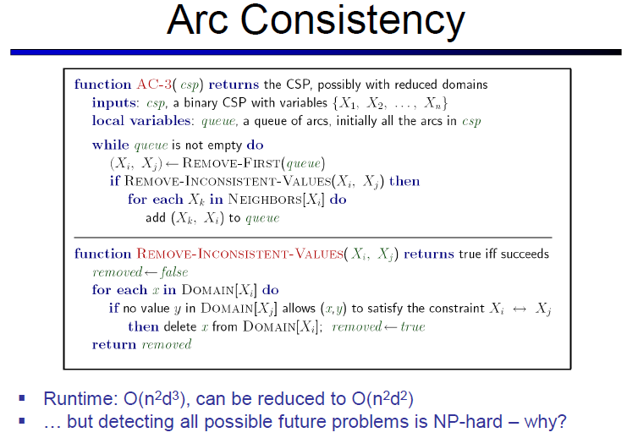
Topic Heading..

Slide 48
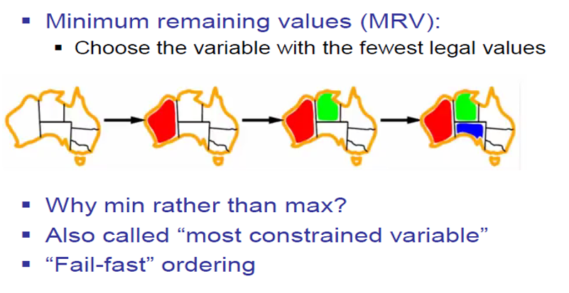
Ordering: Minimum Remaining Value

Slide 49
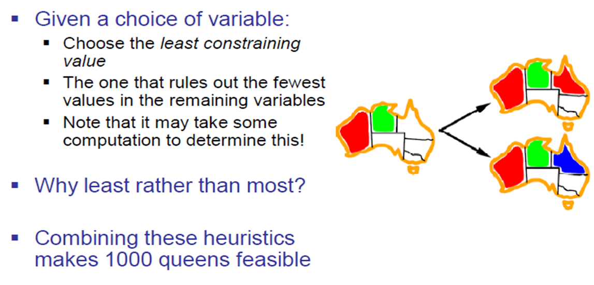
Ordering: Least Constraining Value

Slide 50
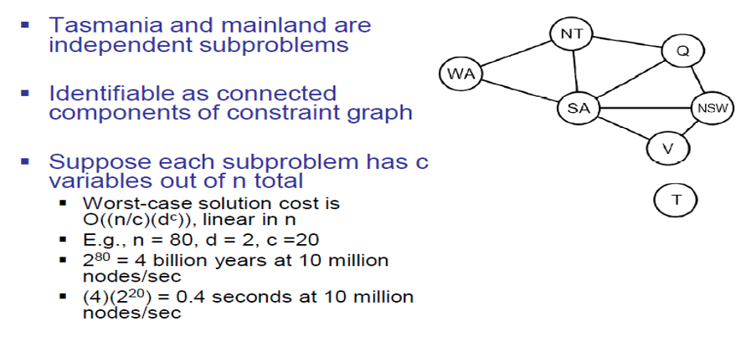
Problem Structure
Dividing a Boolean CSP with 80 variables into four sub problems reduces the worst-case solution time from the lifetime of the universe down to less than a second

Slide 51
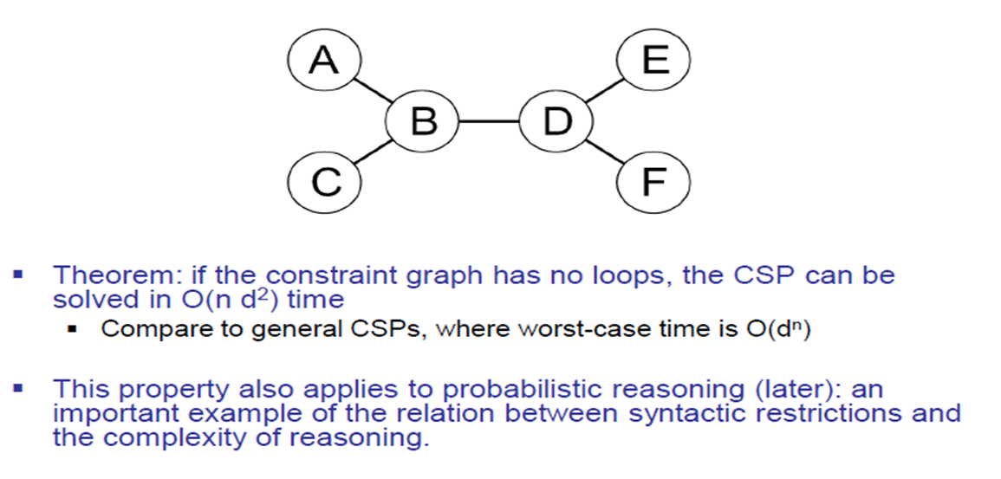
Tree Structure CSPs

Slide 52
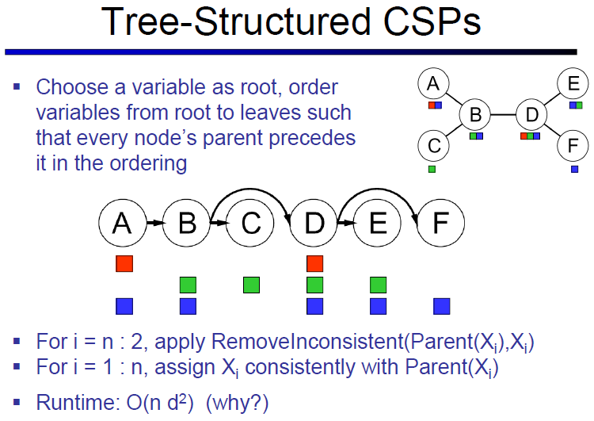
Topic Heading..

Slide 53
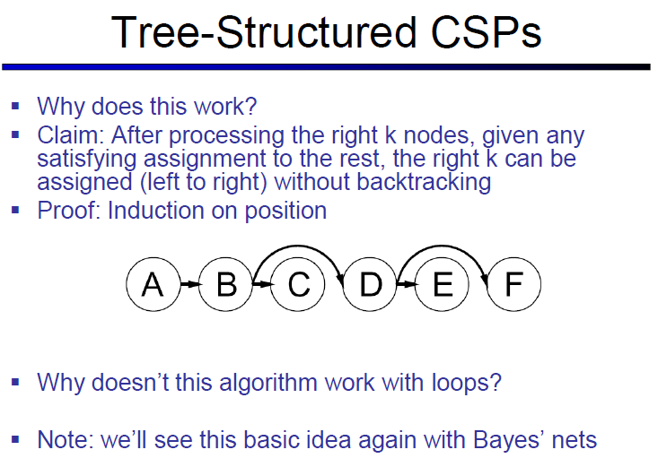
Topic Heading..

Slide 54
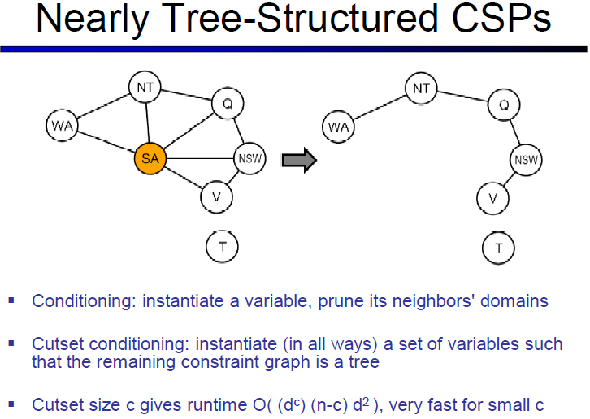

Slide 55
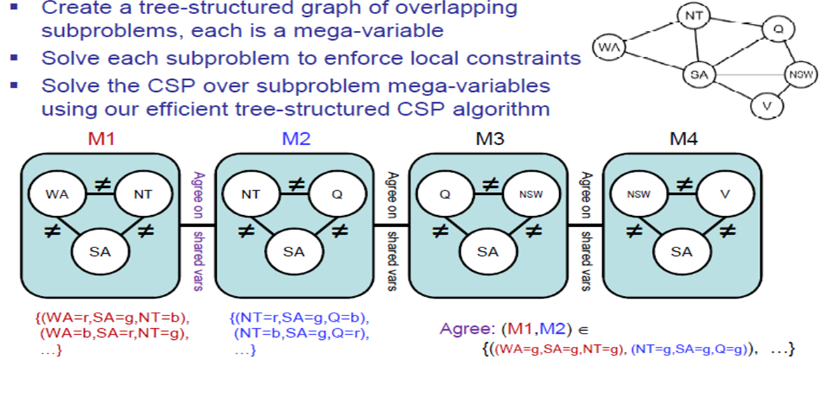
Tree Decomposition

Slide 56
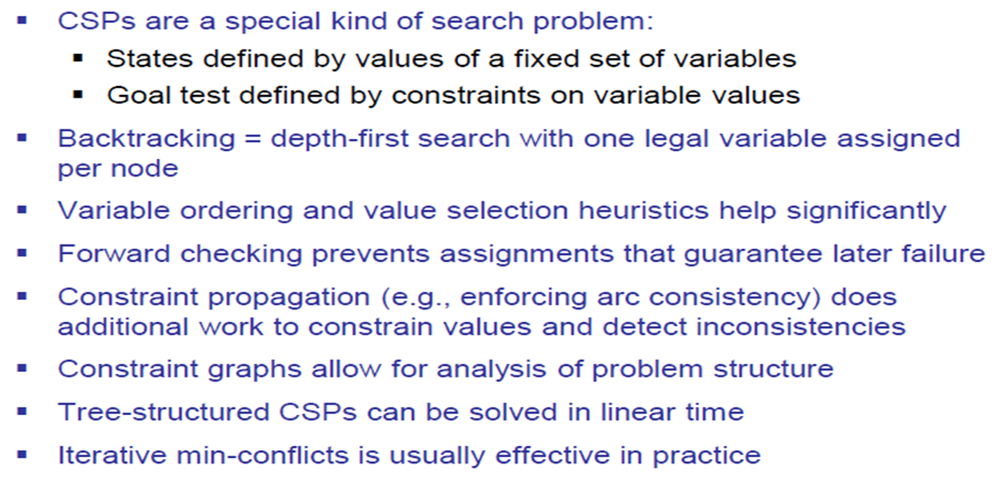
Summary

Slide 57
References
Chapter 6: Introduction , Pages 202-220
“Artificial Intelligence: A Modern Approach,” by Stuart J. Russell and Peter Norvig,

Slide 58
Books
“Artificial Intelligence: A Modern Approach,” by Stuart J. Russell and Peter Norvig.
"Artificial Intelligence: Structures and Strategies for Complex Problem Solving", by George F. Luger, (2002)
"Artificial Intelligence: Theory and Practice", by Thomas Dean.
"AI: A New Synthesis", by Nils J. Nilsson.
“Programming for machine learning,” by J. Ross Quinlan,
“Neural Computing Theory and Practice,” by Philip D. Wasserman, .
“Neural Network Design,” by Martin T. Hagan, Howard B. Demuth, Mark H. Beale, .
“Practical Genetic Algorithms,” by Randy L. Haupt and Sue Ellen Haupt.
“Genetic Algorithms in Search, optimization and Machine learning,” by David E. Goldberg.
"Computational Intelligence: A Logical Approach", by David Poole, Alan Mackworth, and Randy Goebel.
“Introduction to Turbo Prolog”, by Carl Townsend.

